Slide 1


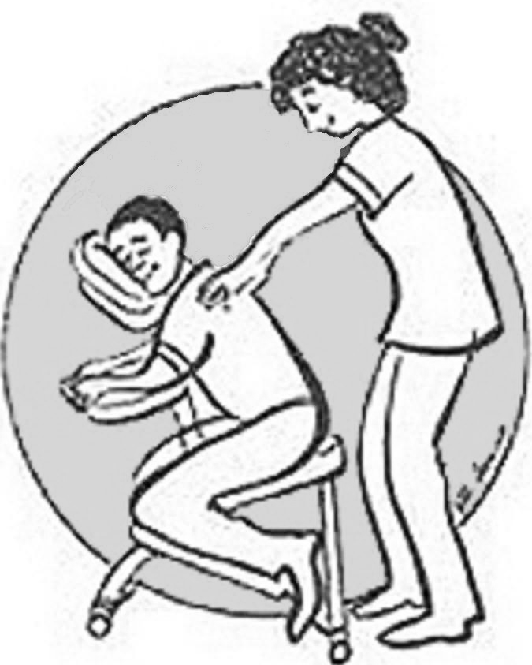

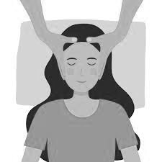
Massage
Foot
Back
Hand
Head
Cuddle Options

Slide 2
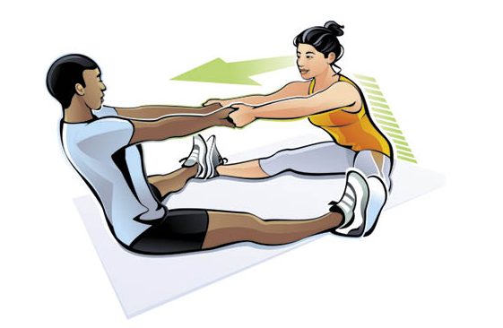
Partner Stretching
Cuddle Options

Slide 3

Talk
(Active listening is a form of touch)
Cuddle Options

Slide 4

Yin-Yang
Cuddle Options

Slide 5
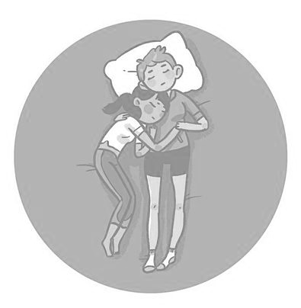
Half Spoon
Cuddle Options

Slide 6
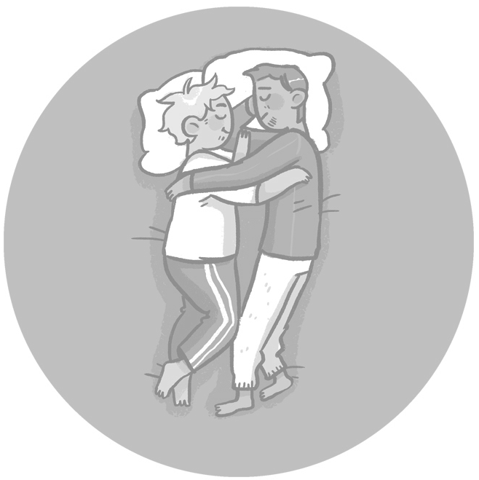
Face to Face
Cuddle Options

Slide 7
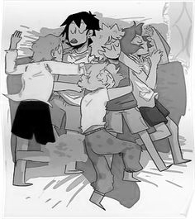
Cuddle Puddle
Cuddle Options

Slide 8
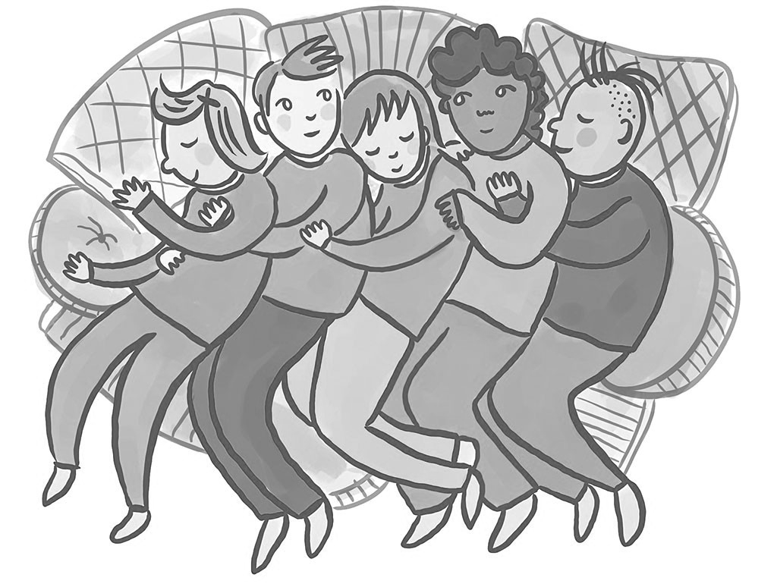
Spoon Drawer
Cuddle Options

Slide 9
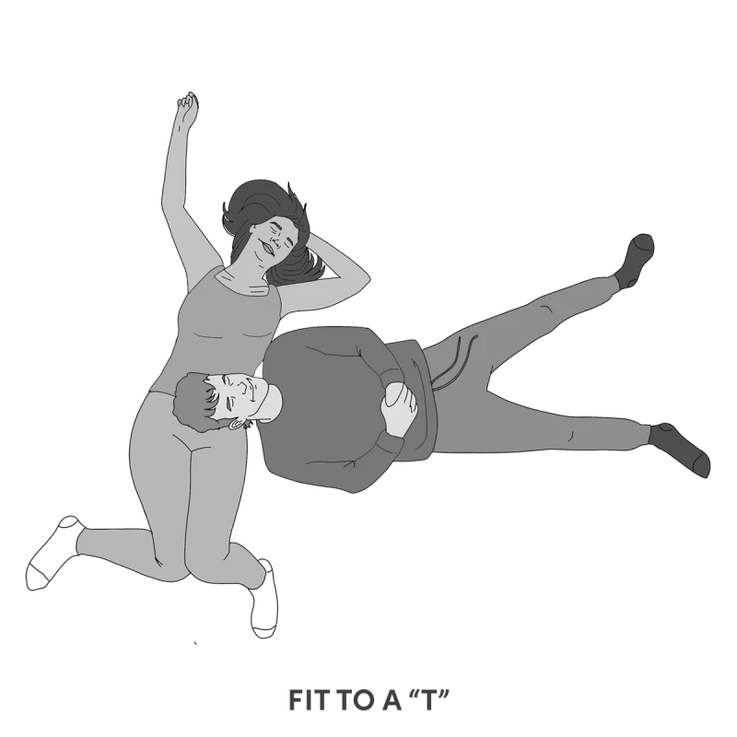
Head in Lap
(laying down)
Cuddle Options

Slide 10
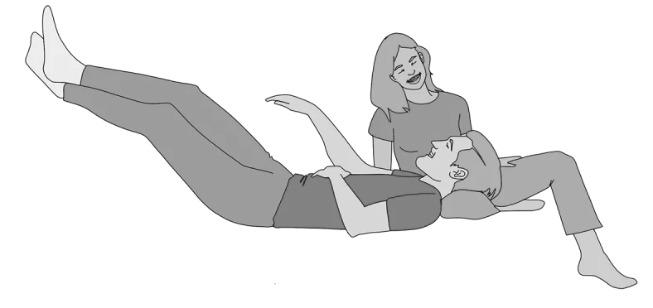
Head in Lap
(sitting)
Cuddle Options

Slide 11
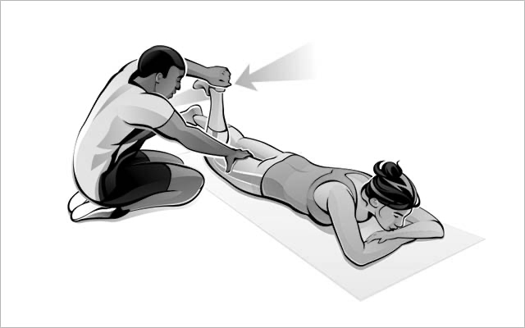
Joint Movement
(for Range of Motion)
Cuddle Options

Slide 12

Brush or play with someone’s hair
Cuddle Options

Slide 13
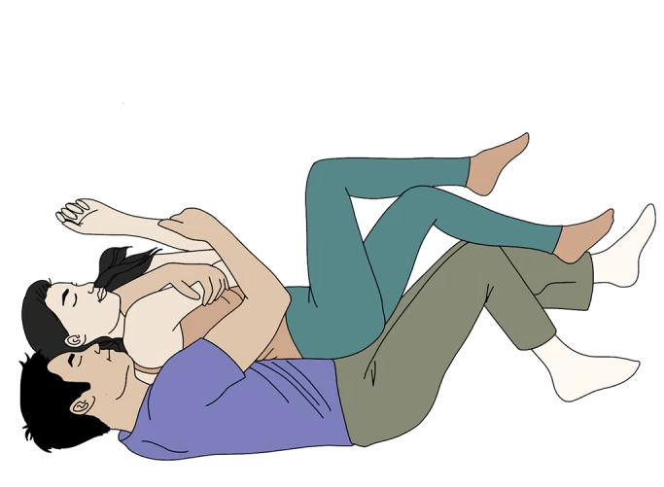
Spooning
Cuddle Options

Slide 14

Back-to-Back
Cuddle Options

Slide 15

Front-to-Back
Cuddle Options

Slide 16
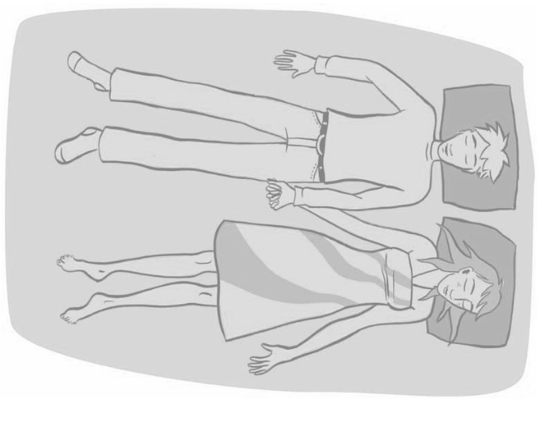
Side-to-Side
Cuddle Options

Slide 17
This is
non-sexual consensual touch
event
Crying and giggling are both welcomed and encouraged
Rules

Slide 18
This is
non-sexual consensual touch
event
For those in a relationship:
Have you discussed your relationship boundaries with your partner?
If not, do so now.
Rules
& honor your relationships

Slide 19
This is
non-sexual consensual touch
event
Always say ‘thank you’ and practice good Cuddle Manners
Rules

Slide 20
This is
non-sexual consensual touch
event
You can leave at any time
Rules

Slide 21
This is
non-sexual consensual touch
event
Please be respectful of other people's privacy
when sharing with the outside world keep people anonymous
Rules

Slide 22
This is
non-sexual consensual touch
event
If you are a ‘Yes’ say ’Yes’
If you are a ‘No’ say ’No’
If you are a ‘Maybe’ say ’No’
Rules

Slide 23
This is
non-sexual consensual touch
event
You don't have to cuddle anyone at a Cuddle Party, ever
Rules

Slide 24


This is
non-sexual consensual touch
event
At anytime you feel uncomfortable the facilitators are here for you
come talk to us privately
Rules
Pamela
Llewellyn

Slide 25
This is
non-sexual consensual touch
event
you must ask permission
and receive a verbal ‘Yes’ before
you touch anyone
Rules

Slide 26
This is
non-sexual consensual touch
event
Pajamas stay on the whole time
Rules

Slide 27
Types of touches:
rubbing
caressing
stroking
massaging
hugging
patting
resting
holding stroking
… and more
Pressure:
soft(er)
hard(er)
Cuddle Options

Slide 28
It’s ok to say
“No”
find your yeses

Slide 29
It’s ok to say
“please stop asking”
find your yeses

Slide 30
It’s ok to
Change your mind
at any time
find your yeses

Slide 31
It’s ok to
ask for what you want
find your yeses

Slide 32
This is a chance to
practice your boundaries
find your yeses

Slide 33
What kind of
touches do you like?
find your yeses

Slide 34
What kind of
touches do
you NOT like?
find your yeses

Slide 35
What would make today
Amazing
for you?
find your yeses

Slide 36
What would like to
Get from this event?
find your yeses

Slide 37
What are your
Cuddle Boundaries?
find your yeses

Slide 38
Warning:
touch can release strong emotions
Honor your Boundaries
You are under no OBLIGATION to caretake for others
find your yeses

